Slide 1
GROUP - 11
1. SAZAL KANTI KUNDU - 21166006 2. MAHMUDUL HASAN SHAKIL - 21166034 3. TAJKIA HOSSAIN - 20366013 4. MD. IBRAHIM KHAN - 18201152 5. MD. MUNTAHA ISLAM - 18101079 6. ANINDA SADMAN - 18101617

Slide 2
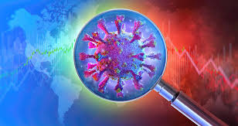



PANDEMIC LITERATURE SEARCH: FINDING INFORMATION ON COVID-19

Slide 3
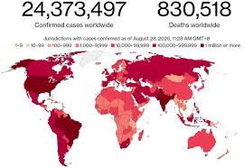
AUTHORS 1. SAZAL KANTI KUNDU - 21166006 2. MAHMUDUL HASAN SHAKIL - 21166034 3. TAJKIA HOSSAIN - 20366013 4. MD. IBRAHIM KHAN - 18201152 5. MD. MUNTAHA ISLAM - 18101079 6. ANINDA SADMAN - 18101617 {1,2,3,4,5,6} DEPARTMENT OF COMPUTER SCIENCE AND ENGINEERING, BRAC UNIVERSITY, DHAKA, BANGLADESH.
GROUP - 11
PROJECT PROPOSAL PRESENTATION OUTLINE
TITLE SLIDES 1
OUTLINE 2
INTRODUCTION 3
DATASETS AND METHODS 4
RESULTS 5
CONCLUSION AND REFERENCE 6

Slide 4


Introduction
PubMed alone indexed over 60,000 articles on COVID-19
TREC COVID Search – An international challenge
Vincent & his team’s method – improves the system using a novel hybrid neural end-to-end approach
Related works – Using of tradition

Slide 5


DATASET
CORD-19 (The Covid-19 Open Research Dataset)
Compiled from three sources: PubMed Central (PMC), the WHO articles, and bioRxiv and medRxiv
Documents are judged for given topics provided by NIST.
Given a topic, a document is judged as: irrelevant (0), partially relevant (1), and relevant (2)
Round | No. Documents | No. Judgments | No. Topics
1 | 51103 | 8691 | 30
2 | 59851 | 12037 | 35
3 | 128492 | 12993 | 40
4 | 157817 | 13312 | 45
5 | 191175 | 23373 | 50

Slide 6
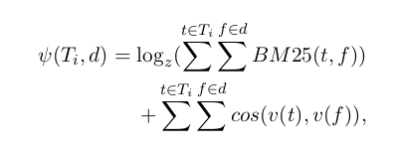


METHODS
Neural Index Retrieval
A hybrid neural index
Append neural representation vectors to the document
representations of a traditional inverted index
Neural representations are created from BERT based sentence encoder
Scoring topic and document pairs
Okapi BM25 scores for all pairs of topic fields and document facets
Calculate cosine similarities for all pairs
The final score adds a log normalized sum of BM25 to the sum of neural scores

Slide 7
Experimental Results
This document was scored highly by BM25.
But much lower in the neural/cosine component.
Removal of facets makes no significant differences.
Model | P@10 | NDCG@10
NIR | 0.852 | 0.796
no neural | 0.744 | 0.808
no BM25 | 0.668 | 0.706
no title | 0.848 | 0.784
no abstract | 0.848 | 0.875
no full text | 0.856 | 0.799
no date filter | 0.834 | 0.775
Ablation studies for their proposed method where document facets, query facets and other aspects of the model are removed.

Slide 8

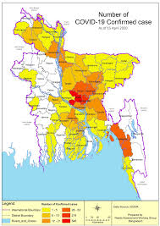
CONCLUSION WE PROPOSE A NOVEL NEURAL RANKING APPROACH (NIR) FOR PANDEMIC INFORMATION RETRIEVAL. EXPERIMENTING WITH THE TREC COVID SEARCH CHALLENGE, WE SHOW THAT OUR METHOD IS COMPETITIVE COMPARED TO OTHER AUTOMATIC SYSTEMS. WE SHOW THAT A NEURAL SCORING IS BENEFICIAL IN ALLEVIATING SOME OF THE SHORTCOMINGS OF THE KEYWORD-BASED RETRIEVAL. EMPIRICALLY, OUR MODEL SHOWS IMPROVEMENTS WITH TIME IN A PANDEMIC SCENARIO WITHOUT ADDITIONAL TRAINING DATA. A BALANCED SCORING FUNCTION COMBINES THE STRENGTHS OF THE INVERTED AND NEURAL INDICES. A NEURAL INDEX EXPLICITLY TRAINED FOR RANKING WOULD BE A SUITABLE AVENUE FOR FUTURE RESEARCH
REFERENCES
ZEYNEP AKKALYONCU YIL.MAZ, WEI YANG, HAOTIAN ZHANG, AND JIMMY LIN. 2019.
CANJIA LI, ANDREW YATES, SEAN MACAVANEY, BEN HE, AND YINGFEI SUN. 2020.
EDWIN ZHANG, NIKHIL GUPTA, RAPHAEL TANG, XIAO HAN, RONAK PRADEEP, KUANG LU, YUE ZHANG, RODRIGO NOGUEIRA, KYUNGHYUN CHO, HUI FANG, AND JIMMY LIN. 2020

